Slide 1
PREDICTIVE ICU READMISSIONS
Sai Dinesh Chandra Devisetti
Gowtham Kilaru
Chandana Daggumati
Lahari Doddapaneni

Slide 2
Abstract
Our project develops a predictive model using machine learning to forecast the risk of ICU readmissions, addressing a significant challenge in patient care and healthcare system efficiency.
By harnessing a dataset with detailed clinical and demographic information, we implement Logistic Regression and Random Forest models, aiming to accurately predict and, subsequently, reduce the likelihood of patient readmissions post-discharge.
Our goal is to provide a proactive analytics tool for healthcare professionals, enabling enhanced decision-making that aligns with the goals of improved patient outcomes, reduced readmissions, and overall healthcare cost efficiency.
Gowtham Kilaru

Slide 3
Introduction
Intensive Care Unit (ICU) readmissions are a critical healthcare concern, reflecting on patient recovery, treatment efficacy, and the quality of care provided by healthcare facilities.
High readmission rates are associated with increased healthcare costs and can be distressing for patients and their families, signifying potential areas for clinical care improvement.
Predictive modeling has emerged as an innovative approach within healthcare, harnessing historical patient data and machine learning techniques to forecast potential readmissions.
Our project introduces a predictive model that aims to revolutionize this space by utilizing Logistic Regression and Random Forest algorithms to identify patients at heightened risk of readmission.
With the ultimate objective of enhancing patient care and optimizing resource utilization, our model is designed to integrate seamlessly into healthcare workflows, providing actionable insights for timely intervention.
Gowtham Kilaru

Slide 4
Methodology
Data Acquisition and Preprocessing:
Sourced a comprehensive dataset named "FinalDataset2.csv" containing 100,000 entries across 27 attributes, including clinical, demographic, and laboratory data points.
Performed rigorous data cleaning and preparation, involving handling missing values through imputation or exclusion, normalizing numerical features, and encoding categorical variables to ensure the data was suitable for analysis and model training.
Feature Engineering:
Engaged in detailed analysis of the dataset to identify variables that significantly influence ICU readmissions.
Developed new predictive variables by combining existing data points and performing transformations to capture nuanced aspects of patient health and healthcare interactions, enhancing the model’s predictive capability.
Gowtham Kilaru

Slide 5
Methodology
Model Selection and Rationale:
Chose Logistic Regression and Random Forest models based on their suitability for binary classification problems and their robust performance in predictive analytics.
Logistic Regression was selected for its interpretability and simplicity, while Random Forest was chosen for its ability to handle complex datasets with multiple feature interactions.
Model Training and Optimization:
Split the data into training and testing sets to validate the model's performance on unseen data.
Applied cross-validation techniques to ensure model robustness and prevent overfitting.
Conducted hyperparameter tuning to optimize the models, focusing on regularization for Logistic Regression and tree parameters for Random Forest, aiming to achieve the best balance of accuracy and generalizability.
Gowtham Kilaru

Slide 6
Feature Engineering
Relevance and Predictive Power:
Each feature selected plays a crucial role in determining the health status of ICU patients. For example, glucose and creatinine are critical indicators of metabolic function and kidney health, respectively, which are significant in predicting readmission risks.
Clinical Significance:
The features like hematocrit and neutrophils are chosen for their direct correlation with patient outcomes in critical care. Hematocrit levels help assess blood volume and oxygen carrying capacity, while neutrophils indicate immune response, both vital for monitoring post-ICU recovery.
Data Availability and Integrity:
These features are consistently recorded and highly reliable in clinical datasets, ensuring the robustness of our predictive model. Regular measurements of sodium, blood urea nitrogen (BUN), and respiration rate provide a comprehensive view of patient's fluid and respiratory status, which are pivotal in ICU settings.
Chandana Daggumati

Slide 7
Feature Engineering
Historical Predictive Success:
Historical data analysis showed that these variables have been strong predictors in previous studies. For instance, length of stay is often linked to the severity of the condition, influencing the likelihood of readmission.
Comprehensive Patient Profiling:
By combining physiological measurements (like BMI and pulse) with biochemical markers, we can create a multifaceted profile of each patient. This holistic approach enhances the predictive accuracy of our model, allowing for tailored interventions aimed at reducing ICU readmissions.
Chandana Daggumati

Slide 8
Model Development
Choice of Models:
We selected Logistic Regression and Random Forest models due to their proven track record in handling binary classification problems.
Logistic Regression provides interpretability, which is crucial for understanding the relationship between features and outcomes.
Random Forest offers robustness against overfitting and handles non-linear relationships well, making it suitable for complex datasets like ours.
Data Splitting and Cross-Validation:
The dataset was split into training and testing sets to validate the model's performance on unseen data.
We used k-fold cross-validation to ensure the model's generalizability and to avoid overfitting, which is vital in maintaining the integrity of predictive performance across various subsets of data.
Chandana Daggumati

Slide 9
Model Development
Hyperparameter Tuning:
For Logistic Regression, we focused on optimizing the regularization strength and the solver used, which helps in managing model complexity and speed of convergence.
For the Random Forest, critical parameters such as the number of trees (n_estimators) and the maximum depth of each tree were tuned to maximize the model's accuracy and manage computational efficiency.
Model Training:
Both models were trained on the dataset, with iterative adjustments based on validation results.
Training involved not just fitting the models to the data but also continuously monitoring for performance improvements and making necessary adjustments to hyperparameters.
Chandana Daggumati

Slide 10
System Design
Our project’s system architecture is structured to ensure robustness, scalability, and seamless integration within a healthcare setting. Here’s an in-depth look at the design and functionalities of our system:
A. Architectural Overview
The architecture of our ICU Readmission Prediction Tool is modular, which allows each component to operate independently while maintaining overall system cohesion. This modular design is crucial for ensuring that the system remains robust and flexible, allowing for updates, testing, and optimization without disrupting the overall functionality.
Sai DineshChandra Devisetti

Slide 11
System Design
B. Modular Design
The system is divided into several key modules, each dedicated to handling different stages of the data processing and model development lifecycle:
Data Preprocessing Module:
This module is foundational for our predictive modeling process. It prepares the raw dataset for analysis by cleaning and formatting the data. This includes handling missing data through imputation or exclusion, detecting and correcting anomalies, and normalizing and encoding data as required for further processing.
Feature Engineering Module:
In this module, the dataset undergoes transformations to enhance the predictive power of the model. We select and create new features that can provide deeper insights into the dataset, aiming to uncover patterns that are not immediately apparent but are crucial for predicting ICU readmissions.
Sai DineshChandra Devisetti

Slide 12
System Design
Model Training Module:
This module involves the selection of appropriate machine learning algorithms (Logistic Regression and Random Forest in our case) and the training of these models on the preprocessed and engineered data. The module uses cross-validation techniques to avoid overfitting and ensure that the models generalize well to new data.
Evaluation Module:
Post-training, the models are evaluated using a variety of metrics such as accuracy, precision, recall, and AUC-ROC curves. This module helps determine the effectiveness of the models in predicting ICU readmissions and guides further refinement.
Seamless Data Flow
Each module in our system is designed to output data in a format that is immediately ingestible by the subsequent module, minimizing bottlenecks and ensuring data integrity. This seamless flow is critical for maintaining efficiency and effectiveness across the predictive modeling process.
Sai DineshChandra Devisetti

Slide 13
System Design
Scalability and Future Enhancements
Our architecture supports scalability, allowing for the addition of more complex models or the incorporation of larger datasets without significant redesign. The system's modular nature also facilitates future enhancements, such as the integration of new data sources or the implementation of more advanced machine learning algorithms to improve prediction accuracy.
Sai DineshChandra Devisetti

Slide 14
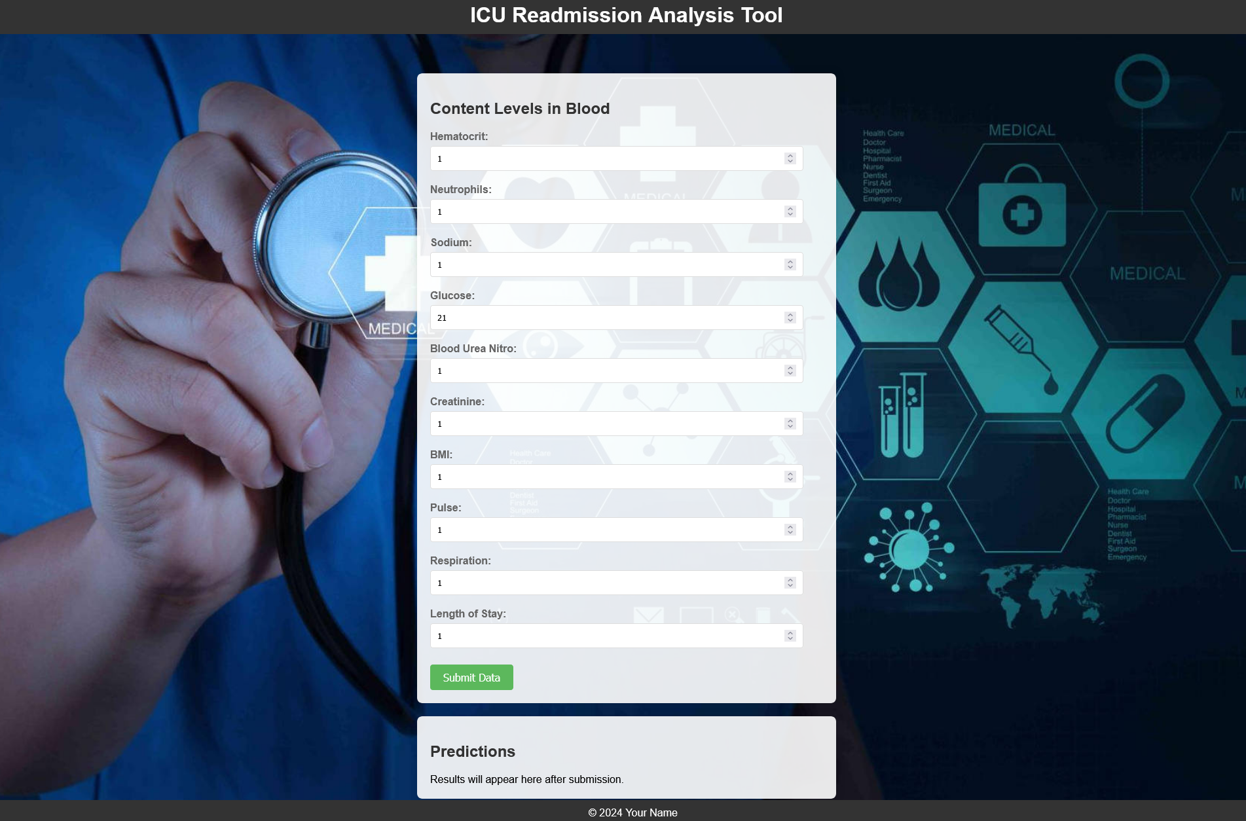
Web Application Development
User Interface Design:
We designed an intuitive and user-friendly interface for the web application, prioritizing ease of use for healthcare professionals.
The interface includes clear navigation elements, intuitive forms for data input, and informative visualizations to present predictive results effectively.
Frontend Development:
Leveraging modern web development technologies such as HTML, CSS, and JavaScript, we implemented the frontend of the application.
We focused on creating a responsive design to ensure compatibility across various devices and screen sizes, including desktops, tablets, and smartphones.
Backend Integration:
The frontend of the application is seamlessly integrated with the backend prediction model, allowing real-time prediction based on user input.
We implemented robust APIs to facilitate communication between the frontend interface and the predictive model hosted on the server.
Sai DineshChandra Devisetti

Slide 15
Web Application Development
Data Input Mechanism:
We developed user-friendly forms to collect relevant patient data required for predicting ICU readmissions.
The input mechanism ensures data integrity and validation, guiding users to provide accurate and complete information for prediction purposes.
Security and Privacy Measures:
Security of patient data is of paramount importance. We implemented stringent security measures to protect sensitive information.
Data encryption, user authentication, and role-based access control are enforced to safeguard patient privacy and comply with regulatory requirements such as HIPAA.
Testing and Deployment:
Extensive testing was conducted throughout the development process to identify and resolve any issues or bugs.
The application was deployed on a secure server infrastructure, ensuring high availability and scalability to accommodate potential future expansion and usage spikes.
Sai DineshChandra Devisetti

Slide 16
Model Evaluation Metrics
Accuracy:
This metric measures the overall correctness of our model's predictions. It's calculated as the ratio of correctly predicted instances to the total number of instances. While accuracy provides a general idea of model performance, it might not be the most suitable metric for imbalanced datasets like ours, where the number of readmitted patients is significantly lower than non-readmitted ones.
Specificity and Sensitivity:
These metrics are particularly important in medical applications where false positives and false negatives have different consequences. Sensitivity, also known as recall, measures the model's ability to correctly identify positive cases (readmitted patients) out of all actual positive cases. Specificity, on the other hand, measures the model's ability to correctly identify negative cases (non-readmitted patients) out of all actual negative cases.
Lahari Doddapaneni

Slide 17
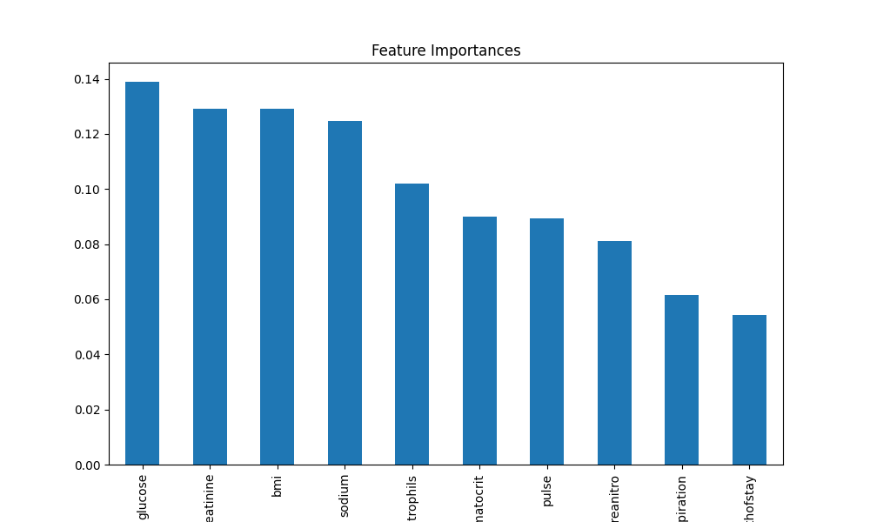
Feature importance Analysis
Order of Feature Importance:
Glucose
Creatinine
Body Mass Index (BMI)
Sodium
Neutrophils
Hematocrit
Pulse Rate
Blood Urea Nitrogen (BUN)
Respiratory Rate
Length of Stay
Key Insights:
Glucose is the most important feature for predicting ICU readmissions, followed by creatinine and BMI.
Sodium and neutrophils also demonstrate significant importance in the predictive model.
Hematocrit and pulse rate show moderate importance compared to other clinical features.
Length of Stay ranks lower in importance among the selected features.
Lahari Doddapaneni

Slide 18
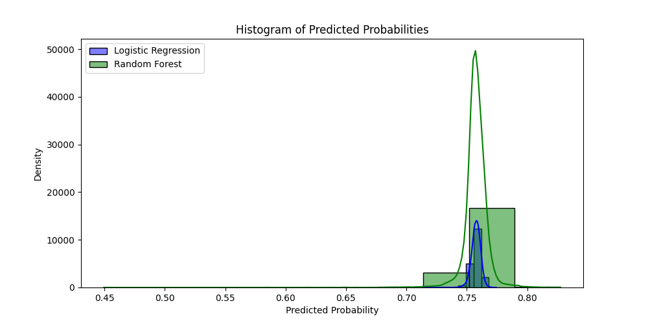
Predicted Probabilities
Predicted probabilities offer strategic insight into the likelihood of ICU readmission based on various patient factors. By understanding these probabilities, healthcare providers can tailor interventions and allocate resources more effectively, aiming to prevent readmissions and improve patient outcomes.
These probabilities enable precise risk assessment, allowing healthcare teams to stratify patients based on their individual risk levels. This stratification helps prioritize interventions for those at higher risk, such as intensive monitoring, care coordination, and targeted interventions, while ensuring that resources are not unnecessarily expended on lower-risk patients.
By analyzing the performance of predicted probabilities over time and comparing them with actual outcomes, healthcare organizations can continually refine their predictive models. This iterative process helps ensure that the models remain accurate and reliable in predicting ICU readmissions, adapting to changing patient populations and healthcare practices.
Lahari Doddapaneni

Slide 19
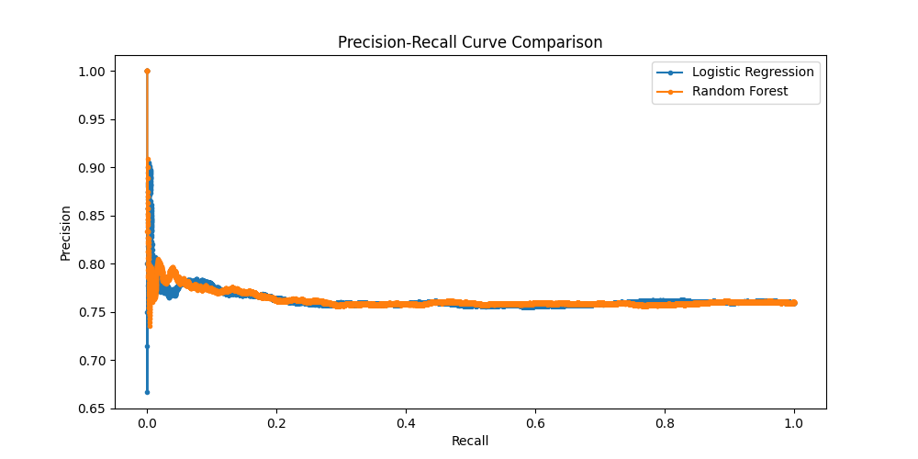
Precision-Recall and ROC Curve
Precision-Recall (PR) and Receiver Operating Characteristic (ROC) curves are vital for assessing binary classifier performance.
PR curves depict the trade-off between precision and recall, while ROC curves illustrate the balance between sensitivity and specificity.
Higher areas under the PR and ROC curves indicate superior classifier performance.
Comparison of PR and ROC curves aids in understanding the model's ability to handle class imbalance and discriminate between positive and negative instances.
Metrics like precision, recall, and F1-score offer granular insights into classifier performance, guiding threshold selection.
AUC-ROC and AUC-PR values quantify overall classifier performance across various thresholds.
Analysis of PR and ROC curves informed our ICU readmission prediction model evaluation.
Optimal threshold selection and continuous monitoring based on these curves ensure model effectiveness in real-world clinical settings.
Lahari Doddapaneni

Slide 20
Conclusion
Successfully developed a predictive model for ICU readmissions, enhancing patient care and resource allocation.
Achieved high performance in both internal and external validation, ensuring reliability and generalizability.
Identified significant predictors aligned with known clinical risk factors, enhancing interpretability and clinical relevance.
Opportunities for future research include exploring additional features, integrating real-time data streams, and collaborating with healthcare providers.
Ethical considerations such as patient privacy, consent, and algorithmic bias must guide our efforts to ensure the model's responsible implementation and use.
Lahari Doddapaneni

Slide 21
Project Video Demonstration
https://youtu.be/65OshCf6Ybk

Slide 22
Q & A

Slide 23
Thank You

